Slide 1
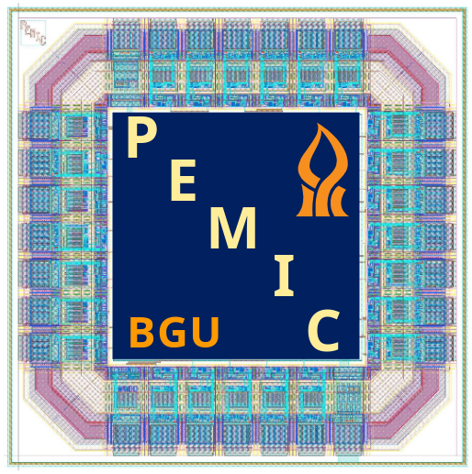
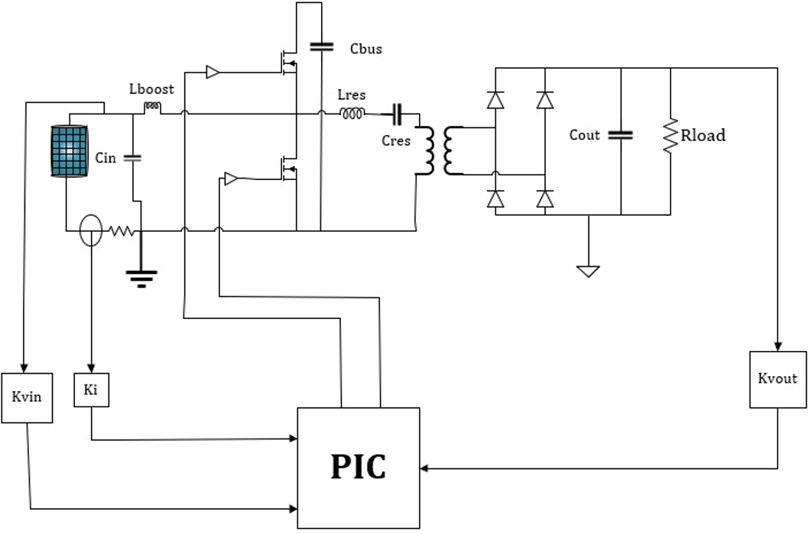
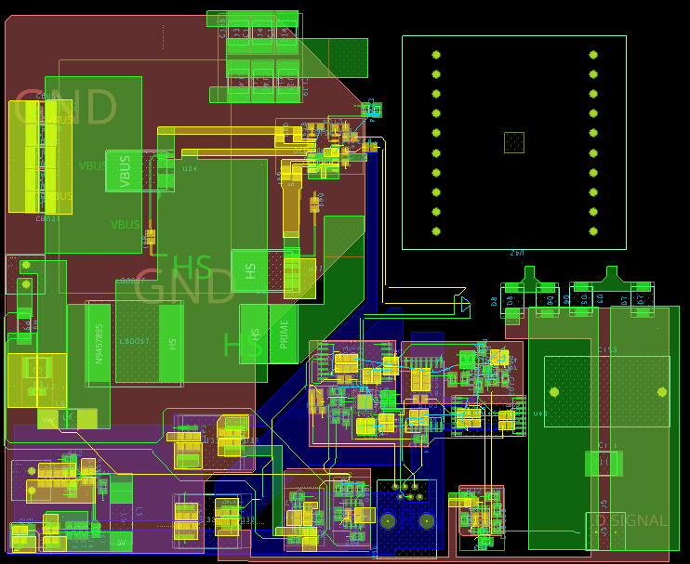
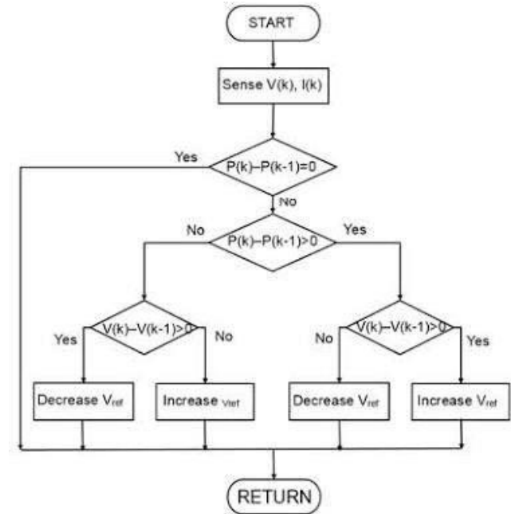
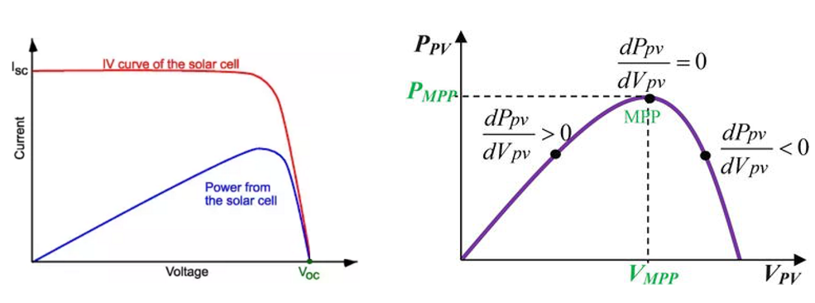
P-2022-040
Faculty of Engineering Sciences
School of Electrical & Computer Engineering
Multi Source Docking Station
Bar Moskovich, Noam Galili
Advisors: Prof. Mor Peretz, Guy Bar Sovik
Introduction
Merged PWM resonant converter
In recent years drones have been integrated into the industry for numerous application: shipping, warfare, law enforcement, etc.
Major problem is long-term flight due limited battery lifetime of the drone.
The solution is compact charging stations, using renewable energy
By using merge PWM resonant converter The solution is implemented
Maximum power transfer requirement even when working conditions changes.
For this requirement we will need a control system that will maintain the output voltage
PCB design
MPPT algorithm
Conclusion
The converter keep stable DC output voltage despite changes in input voltage
Independently control duty cycle and switch frequency allow us to stable the output voltage while achieving MPPT.
The drone will achieve his energy and reach his destination.
Notes:
צריך לעבור על הניסוח של הדברים
צריך להקטין את התרשים של הקוד

